Slide 1

INT 306
Database Management Systems
Lecture 3
‘ Let’s move toward the better way to store and manage the data’

Slide 2


What to model?
Static Information
Data-----Entities
Associations----Relationships among entities
Dynamic Information
Processes--- operations/transactions
Integrity Constraints---Business rules/regulation and data meanings

Slide 3

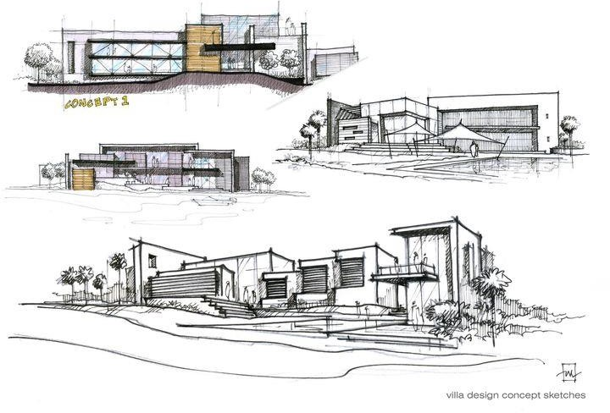
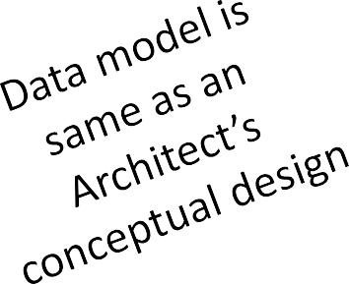
Data Modelling
Data modeling is the process of creating a data model for the data to be stored in a Database. This data model is a conceptual representation of
Data objects
The associations between different data objects
The rules.

Slide 4
Importance of Data Models
Data Models
Represents graphical or complex real world data structures
Facilitate interaction among the designer, the application programmer and the end user
End users have different views and needs for data
Data model organizes data for various users

Slide 5
Types of Data Model
File Based Approach
Hierarchical Model
Network Model
Relational Model
ER Model
Object Oriented Model

Slide 6
File Based Approach
A collection of un-related files and a collection of application programs that perform services for the end users, such as the production of reports. Each program defines and manages its own data.
1. Traditionally each department in a company would maintain its own collection of files
2. The data processing department would write programs for each application each office needed performed.

Slide 7
Limitations of the file-based approach
Duplication of data
Incompatible File Formats
Data dependence
Fixed queries/proliferation of application programs
Inability to generate timely reports

Slide 8
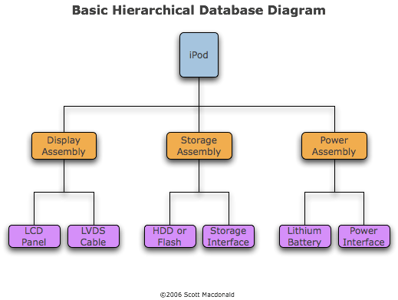

Hierarchical Model
Oldest data base model
Tree structure is most frequently occurring relationship
Organize data elements as tabular rows.
The hierarchical structure was developed by IBM in the 1960s, and used in early mainframe DBMS.

Slide 9
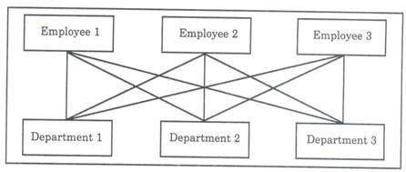

Network Model
Graph Structure
Allow more connection between nodes
Example: An employee work in two departments is not possible in hierarchical model, but here it is possible.
A database system came available in 1964, that called the Integrated Data Store (IDS), and was developed by Charles Bachman. IDS used the network model.

Slide 10
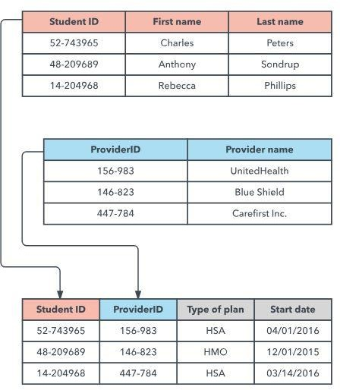

Relational Model
The most common model, the relational model sorts data into tables, also known as relations, each of which consists of columns and rows.
A particular attribute or combination of attributes is chosen as a primary key that can be referred to in other tables, when it’s called a foreign key.
The attributes in a relation are called a
domain.
Each row, also called a tuple, includes data about a specific instance of the entity in question
E.F. Codd published an important paper in 1970s to propose
the use of a relational database model, and his ideas changed the way people thought about databases.

Slide 11
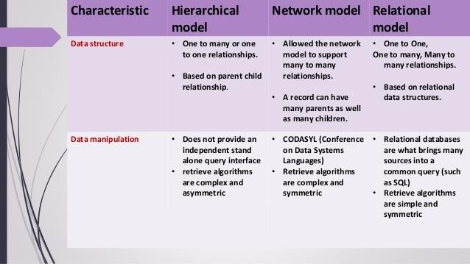
Difference between three data models

Slide 12
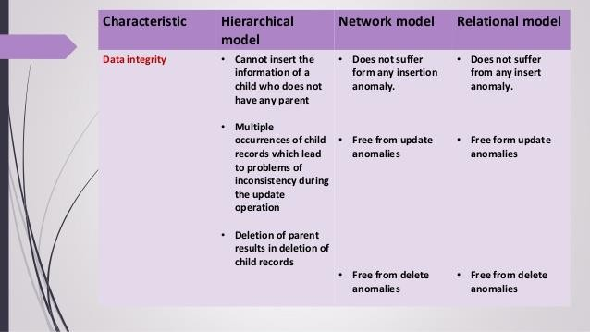
Difference between three data models

Slide 13

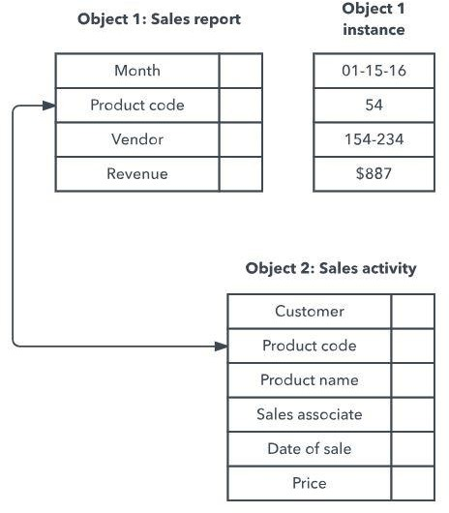
Object Oriented Data Model
Orion Research Project at MCC headed by Won Kim was the first major project initiated for the development of OODBMS in 1990.
This model defines a database as a
collection of objects, or reusable
software elements, with associated features and methods.
There are several kinds of object- oriented databases:
A multimedia database incorporates
media, such as images, that could not be stored in a relational database.
A hypertext database allows any object
to link to any other object. It’s useful for
organizing lots of disparate data, but it’s
not ideal for numerical analysis.

Slide 14
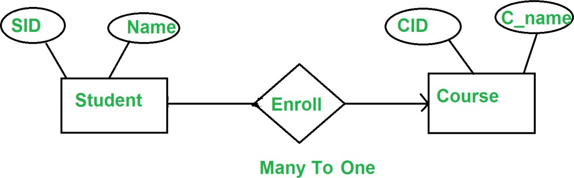
Entity Relationship Model
The ER model defines the conceptual view of a database.
It works around real-world entities and the associations among them.
At view level, the ER model is considered a good option for designing databases.

Slide 15
Quiz!!
A logical schema
is the entire database
is a standard way of organizing information into accessible parts.
Describes how data is actually stored on disk.
All of the above

Slide 16
. ………………… is a full form of SQL.
Standard query language
Sequential query language
Structured query language
Server side query language

Slide 17
A relational database developer refers to a record as
a criteria
a relation
a tuple
an attribute

Slide 18
An advantage of the database management approach is
data is dependent on programs
data redundancy increases
data is integrated and can be accessed by multiple programs
none of the above

Slide 19
Grant and revoke are ……. statements.
DDL
TCL
DCL
DML

Slide 20
Data independence means
data is defined separately and not included in programs.
programs are not dependent on the physical attributes of data
programs are not dependent on the logical attributes of data
both B and C

Slide 21
A top-to-bottom relationship among the items in a database is established by a
Hierarchical schema
Network schema
Relational Schema
All of the above

